Slide 1
Clauses 4-6 Of ISO27001:2013 (ISMS)
Lets have a look at clauses 4-6

Slide 2

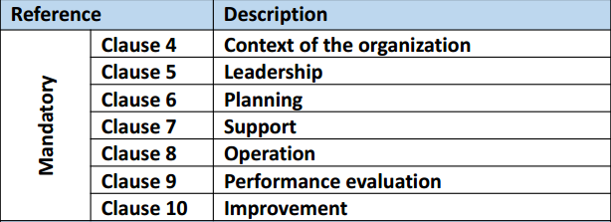
Clauses 4-6 Of ISO27001:2013 (ISMS)
ISO27001:2013 MANDATORY CLAUSES
https://chapters.theiia.org/bermuda/Events/ChapterDocuments/Information%20Security%20Management%20System%20%28ISMS%29%20Overview.pdf

Slide 3
Clauses 4-6 Of ISO27001:2013 (ISMS)
4: Context:
Understanding org and its context; internal and external issues relevant to its purpose and that affect its ability to achieve intended outcomes of ISMS

Slide 4
Clauses 4-6 Of ISO27001:2013 (ISMS)
4: Context:
Needs and expectations of interested parties (e.g. legal and regulatory reqmts and contractual obligations)
Scope (boundaries); interfaces and dependencies

Slide 5
Clauses 4-6 Of ISO27001:2013 (ISMS)
5: Leadership & Commitment
Policy & objectives are established and are compatible with strategic direction of org
Integrating ISMS into org processes
Resources for ISMS available

Slide 6
Clauses 4-6 Of ISO27001:2013 (ISMS)
5: Leadership & Commitment
Communicating importance
Ensuring ISMS achieves intended outcomes
Directing & supporting persons
Promoting continual improvement

Slide 7
Clauses 4-6 Of ISO27001:2013 (ISMS)
5: Leadership & Commitment
Assign and communicate roles, responsibilities & authorities

Slide 8
Clauses 4-6 Of ISO27001:2013 (ISMS)
6: Planning
Address org risks & opportunities & prevent or reduce undesired effects
Ensure risk assessment is conducted
Identify, analyze, evaluate risks
Ensure risk treatment is effective

Slide 9
Clauses 4-6 Of ISO27001:2013 (ISMS)
6: Planning
Address org risks & opportunities & prevent or reduce undesired effects
Ensure risk assessment is conducted
Identify, analyze, evaluate risks
Ensure risk treatment is effective

Slide 10
Clauses 4-6 Of ISO27001:2013 (ISMS)
6: Planning
Ensure information security objectives are measurable, communicated
For objectives determine what will be done, what resources reqd, who will be responsible, when completed, how to evaluate results

